Slide 1


Game Development in Unity 3D using C#, Boo and JavaScript
National Institute of Science & Technology
National Institute of Science & Technology
BY
Debashis Pradhan 201210268
Ankur Upadhyay 201216265
Under the Guidance of
Mr. Debananda Kanhar
1

Slide 2

Game Development Overview
WHY UNITY
The Power of Scripting
One Source to rule them all
SCOPE
Educational
Simulation
Entertainment
IDEATION
What does the player do?
Where it is done?
How does it look and feel?
National Institute of Science & Technology
National Institute of Science & Technology
2

Slide 3
Asset Creation and Acquiring
Standard Assets
Bitmap Graphics and Vector Graphics
3D Graphics
Sound Editors and creators
Online Resources
National Institute of Science & Technology
National Institute of Science & Technology
3

Slide 4
Game Design Process
Designing Game Play, Levels and Balance
Prototyping and Playtesting
Game GUI
Game Documentation
National Institute of Science & Technology
National Institute of Science & Technology
Design
Play
Experience
4

Slide 5
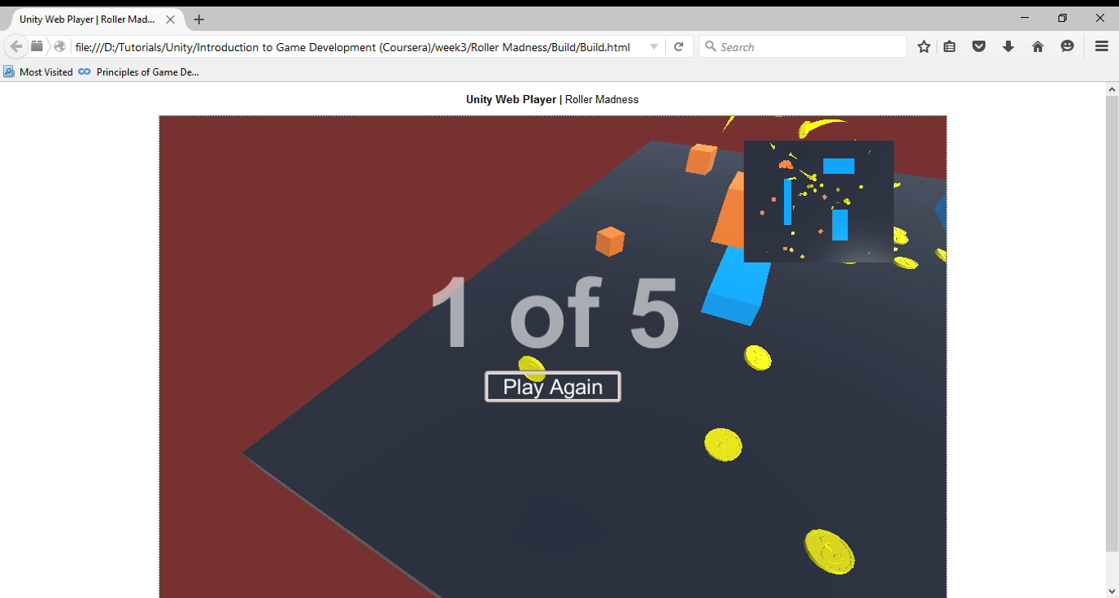
A Roller Ball Experience
National Institute of Science & Technology
National Institute of Science & Technology
5

Slide 6
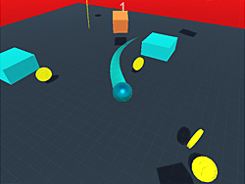
Level Abstract
Camera
Player Setup
Lighting
Physics Engine
Animation
National Institute of Science & Technology
National Institute of Science & Technology
6

Slide 7
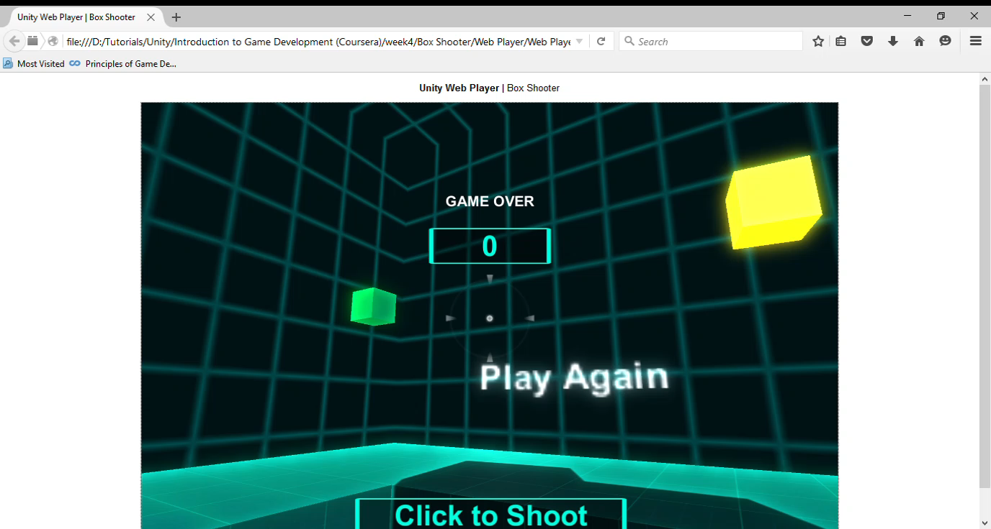
A Box Shooting Experience
National Institute of Science & Technology
National Institute of Science & Technology
7

Slide 8


Unity Programming
Monodevelop
Scripting
Health and Pickups
Spawners
Chasing
Game Manager
National Institute of Science & Technology
National Institute of Science & Technology
8

Slide 9
Build and Deploy
Web Player
PC, Mac & Linux standalone
Android and iOS
Windows store
Consoles : Xbox, PSX
National Institute of Science & Technology
National Institute of Science & Technology
9

Slide 10
Future Work
High Concept Document
Modelling
Implementation
National Institute of Science & Technology
National Institute of Science & Technology
10

Slide 11
References
[1] Unity 3D Manual
http://docs.unity3d.com/Manual/index.html
[2] Unity Script Reference
http://docs.unity3d.com/ScriptReference/index.html
[3] MSUs Game Development Program
http://gamedev.msu.edu/
[4] Game Development using Unity, 1st edition, Cengage, by Michele Menard
National Institute of Science & Technology
National Institute of Science & Technology
11

Slide 12
Thank You
National Institute of Science & Technology
National Institute of Science & Technology
12

